Slide 1
Zero-Cost Pathways: Updates from Sacramento and Next Steps
Sarah Harmon, OER/ZTC Coordinator and the Textbook Affordability Subcommittee of the Academic Senate
“Zero-Cost Pathways: Updates from Sacramento and Next Steps” by Dr. Sarah Harmon of Cañada College is licensed under CC-BY 4.0.

Slide 2
01
TABLE OF CONTENTS
02
03
04
$
What Is a Course Material?
What Are These CCCCO Grants?
Cañada’s Next Steps
Connections to Planning
Some Q&A at the end 😊

Slide 3
What Is a Course Material?

Slide 4
Course Materials
Yes, these are ‘course materials’*!
No, these are not ‘course materials’*.
Textbooks
Lab manuals
Homework platforms/sites
Streaming videos
Library-based resources
Applications that students use to do their work
Lab kits
Art supplies
Calculators
Yoga mats
*This is based on California Community College Education Code 78052 (b)(5)

Slide 5
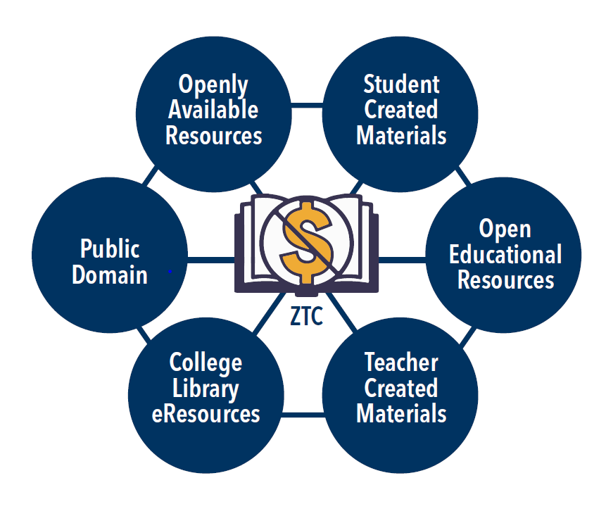
What is Zero Textbook Cost (ZTC)?
ZTC Wheel by Ame Maloney for Skyline ZTC is licensed CC BY.

Slide 6
What Are These CCCCO Grants?

Slide 7
CCCCO Zero-Cost Pathways Grants
Phase 1
Phase 2
Phase 3
$20,000/college
‘By apportionment’ (= guaranteed)
Meant to help plan for Phase 3
Colleges submit individual ‘applications’
Money comes in January (mostly) and throughout Spring 2023
Up to $200,000
Competitive grants
Meant to be for ADTs/CofAs that are mostly there, just need a bit more help
If multiple colleges submit plans for similar projects, they can collaborate
Funds must be spent and program complete by June 30, 2024
$180,000
‘By apportionment’ (= guaranteed), so long as the college submits for Phase 1
Creation of zero-cost ADTs and Certificates of Achievement
Information from the ASCCC OERI slide deck for the “Everything We Think We Know About the Zero Textbook Cost (ZTC) Program” webinar, 7 October 2022

Slide 8
Other Important Information
Colleges are to develop new or existing ADT/Certificate of Achievement zero-cost programs
Focus on high-value programs AND/OR meets an emerging regional business industry need AND/OR those with high textbook costs
These funds can be used for professional development and technical assistance
Pathways and hiring are determined locally
Everything must be able to be institutionalized after the funding has run out
Academic Senate is to be consulted with respect to implementation of the Pathways
Information from the ASCCC OERI slide deck for the “Everything We Think We Know About the Zero Textbook Cost (ZTC) Program” webinar, 7 October 2022

Slide 9
Other Important Information
Pathways must include:
Core courses
Selectives
GEs
Need to offer as many sections as possible for each course as ZTC
Materials adopted, remixed or authored must be accessible and customizable (CC-BY, CC-BY-NC)
ADT/Certificate Pathways should be implemented within 3 academic years of receiving funding, if not sooner.
Information from the ASCCC OERI slide deck for the “Everything We Think We Know About the Zero Textbook Cost (ZTC) Program” webinar, 7 October 2022

Slide 10
What Is Still Murky
Opening date of Phase 2 and Phase 3
How duplication for Phase 2 pathways is to be avoided
How reporting will be done for Phase 2 and Phase 3, exactly
Mechanisms to allow for cross-college collaboration for Phase 2
Information from the ASCCC OERI slide deck for the “Everything We Think We Know About the Zero Textbook Cost (ZTC) Program” webinar, 7 October 2022

Slide 11
Cañada’s Next Steps

Slide 12
Phase 1: $20,000
Spring 2023 cohort of ZTC Adopter Program (4-5 projects)
$500 for training
$750 for adoption; $2,000 for remix
Focus on GE courses not already converted
Funding for Library resources (e.g. eBooks, subscriptions)
OER/ZTC Training for Student Tech Assistants, Embedded Tutors and Peer Mentors
Student outreach to those enrolled in Fall 2022 ZTC/LTC courses
What’s working well?
What are the needs/challenges?

Slide 13
Where Are We with GEs?
IGET-C | ZTC OK?
ENGLISH COMMUNICATION (6-9 units) | Growing, especially in COMM, but could use more ENGL
MATHEMATICAL CONCEPTS AND QUANTITATIVE REASONING (3 units) | Can be done (3 ZTC), but could use more growth
ARTS AND HUMANITIES (9 units) | Good (9 ZTC), but need to work on more representation across disciplines
SOCIAL AND BEHAVIORAL SCIENCES (9 units) | Strong (14 ZTC, 6 LTC), but could use more representation across disciplines
PHYSICAL AND BIOLOGICAL SCIENCES (7 units) | Strong (12 ZTC), but could be stronger
LOTE (1 course or equivalency) | Only 3 course are ZTC; area of growth
CSU | ZTC OK?
ENGLISH LANGUAGE COMMUNICATION AND CRITICAL THINKING (9 units) | Improving, especially in COMM, but could use more ENGL, PHIL
SCIENTIFIC INQUIRY AND QUANTITATIVE REASONING (9 units) | Strong (15 ZTC), but could use more growth
ARTS AND HUMANITIES (9 units) | Good (14 ZTC, 4 LTC), but need to work on more representation across disciplines
SOCIAL SCIENCES (6 units) | Strong (17 ZTC, 4 LTC), but could use more representation across disciplines
LIFELONG LEARNING AND SELF DEVLEOPMENT (3 units) | Adding more DANC/FITN courses, but not many courses available
ETHNIC STUDIES (3 units) | All ZTC!

Slide 14
Phase 2: Up to $200,000*
ADT + GE Pathways
We need more robust coverage over all GE areas
Likely candidates include COMM, ANTH, ETHN (in various GE categories)
Further bolstering of ZTC Adopter Program to expand cohorts to be every semester + summer to do this work
Further funding for more Library resources (e.g. eBooks, subscriptions)
Further training for faculty and students, including improving Canvas-based training
Opportunities for faculty to author, not just remix/adopt
*This is the idea…still fleshing things out…looking for input!

Slide 15
Phase 3: $180,000*
Expanding to as many ZTC Pathways (both ADTs and Certificates) as possible
Likely candidates include ANTH, ECE, PHYS, MATH, ETHN
Would like to engage all departments in this work
Funding would be to expand ZTC Adoption Program to every semester + summer
Addressing the student needs (data from student engagement work in Phase 1)
Further funding for more Library resources (e.g. eBooks, subscriptions)
Further training for faculty and students, including improving Canvas-based training (if we don’t get Phase 2 funding)
Opportunity for faculty to author, not just remix/adopt
*This is the idea…still fleshing things out…looking for input!

Slide 16
Connections to College Planning

Slide 17
How Does This Work Fit In?
EMP Goals
1.19: “Reduce or eliminate the cost of textbooks and course materials by ensuring 75% of all course sections utilize OER…by 2030.”
2.5: “Increase use of OER that address diversity, equity, inclusion and antiracism in the course material content.”
OER/ZTC Implementation Plan:
Increased use of open pedagogical materials to address diversity, equity, inclusion, and antiracism.
Increased student engagement re: materials and usage
ASCC Student Goals on Textbook Affordability

Slide 18
How Can You Get Involved?
Textbook Affordability Subcommittee
ZTC Adopter Program
4th Tuesday of the month, 12:30-1:30pm, FTLCL (9-154) or Zoom
Summer cohort every year
More cohorts as we get more funding
Textbook Adoptions
Student Engagement
Get them in on-time!
Check in with Sarah and Diana to see how we can help with OER and ZTC materials
Share any survey and focus group announcements with your students!
Spread the word about your ZTC/LTC courses!

Slide 19
Q & A

Slide 20
THANKS!
Sarah Harmon, OER/ZTC Coordinator
harmons@smccd.edu
Textbook Affordability Subcommittee of the Academic Senate
Textbook Adoption Process
ZTC Adopter Program
OER/ZTC Implementation Plan

