Slide 1
Course Enrollment and Modalities Spring 2024 Census Day
Office of Instruction
2.5.2024

Slide 2
EMP 1.3 Create a student-first course schedule EMP 4.12 Offer key courses in multiple modalities
A student-first course schedule is the outcome of a thoughtful and collaborative process that prioritizes student success, minimizes disruptions, aligns programs, and balances faculty workload.
Student-first Scheduling and Modalities:
Offering diverse course modalities, including face-to-face, hybrid, asynchronous online, synchronous online, and multi-modalities, to cater to various learning preferences.
Considering the day of the week, time of day, and location to accommodate student needs and preferences.
We ensure course schedules are aligned to minimize conflicts, enabling students to plan and complete their educational goals efficiently.
ACCJC Standard 2.6:The institution uses delivery modes and teaching methodologies that meet student and curricular needs and promote equitable student learning and achievement.

Slide 3
Census Day: Point-in-Time Comparison
Metric | Spring 2023 2.6.2023 | Spring 2024 2.5.2024 | Percent Change
Enrollments | 10,691 | 12,266 | 14.7%
Headcount | 5,803 | 6,747 | 16.3%
Headcount (First-Time) | 264 | 311 | 17.8%
Headcount (Int'l) | 73 | 89 | 21.9%
Sections (unduplicated) | 443 | 480 | 8.3%
Load | 395 | 428 | 10.4%
FTEF | 98 | 106 | 8.1%
Concurrent K-12 Student | 536 | 869 | 62.1%
Continuing Student | 4,066 | 4,895 | 20.4%
Enrollments (Evening) | 670 | 923 | 37.8%

Slide 4
Exceeded College Goals
 | Course Enrollment | Headcount | Fill Rate | FTES | FTEF | Load | Sections (undup)
College Goal | 11,000 | 5,337 | 70% | 1271.0 | 93.0 | 400 | 450
Spring 2024 (Census Day) | 12,266 | 6,747 | 74% | 1503.1 | 105.5 | 428 | 480
Online Asynchronous | 4,855 |  | 85% |  |  | 547 | 146
Online Synchronous | 967 |  | 68% |  |  | 412 | 37
Hybrid | 1,784 |  | 76% |  |  | 395 | 77
F2F | 4,635 |  | 67% |  |  | 370 | 220
Notes:
These are the enrollment metrics that Canada is tracking and monitoring. We set our College goal for each of the enrollment metrics. Fall 2023, we exceeded our college goals.

Slide 5
Effective Management of Modalities and Enrollment
Spring 2024 Census Day
Notes:
Excellent job of Managing Modalities and Enrollment. Met student demand (with balancing fill rate, capacity, and modalities)
Fill rate: use fill rate to gauge the capacity and student demands; We are in the sweet spot.
Note: depending on the department
42% of F2F sections (246) account for 31% of enrollment (3422).
40% of Online sections (241) both async and sync (157+84=241) count for 52% of enrollment (5740) (4305+1435=5740).
18% of hybrid (105) count for 17% of enrollment (1876).
Definition on Modalities: https://smccd.edu/academicsenate/documents/dtlc/Distance%20Education%20Modalities%20Public%20Facing%20Descriptions%20Feb2023.pdf

Slide 6
Effective Management of Modalities and Enrollment
Spring 2023 Census Day
Notes:
Excellent job of Managing Modalities and Enrollment. Met student demand (with balancing fill rate, capacity, and modalities)
Fill rate: use fill rate to gauge the capacity and student demands; We are in the sweet spot.
Note: depending on the department
42% of F2F sections (246) account for 31% of enrollment (3422).
40% of Online sections (241) both async and sync (157+84=241) count for 52% of enrollment (5740) (4305+1435=5740).
18% of hybrid (105) count for 17% of enrollment (1876).
Definition on Modalities: https://smccd.edu/academicsenate/documents/dtlc/Distance%20Education%20Modalities%20Public%20Facing%20Descriptions%20Feb2023.pdf

Slide 7
Metrics and Actual Information by Division
Enrollment & Fill Rate by Division | Enrollment | Fill Rate | Load | Duplicated Section (CRN)
Bus. Design & Workforce (BDW) | 3,557 | 71% | 387 | 159
Counseling | 134 | 61% | 380 | 6
Humanities & Soc. Sci. (HSS) | 4,060 | 77% | 378 | 203
Kinesiology, Athl & Dan (KAD) | 1,132 | 69% | 446 | 128
Science & Technology (ST) | 3,198 | 80% | 508 | 126
Academic Sup & Learn T (ASLT) | 143 | 26% | 706 | 11
Grand Total | 12,2224 | 73% | 425 | 633
Notes:
Definition for each metrics
Class Max: room capacity. Who define the max? who decides it?

Slide 8
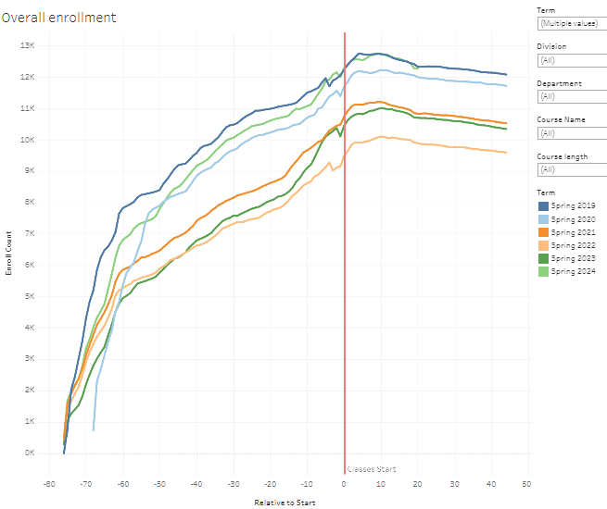
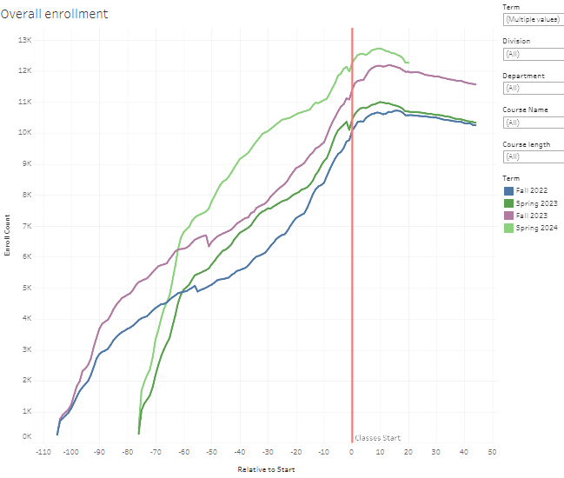
Enrollment Overall Trends (Census Day 2.5.2024)
https://public.tableau.com/app/profile/alex.claxton/viz/FillRateDashboard/OverallEnrollments

Slide 9
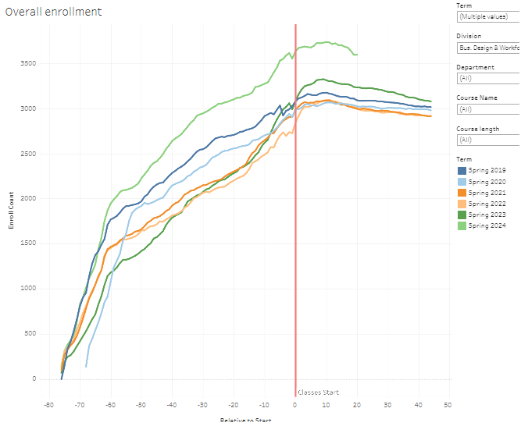
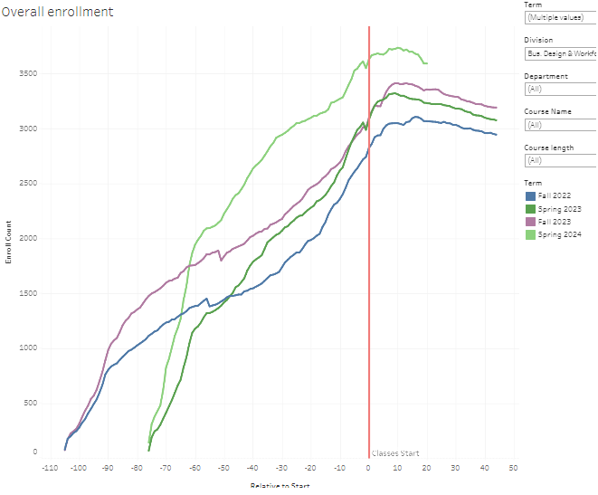
Business Design & Workforce

Slide 10
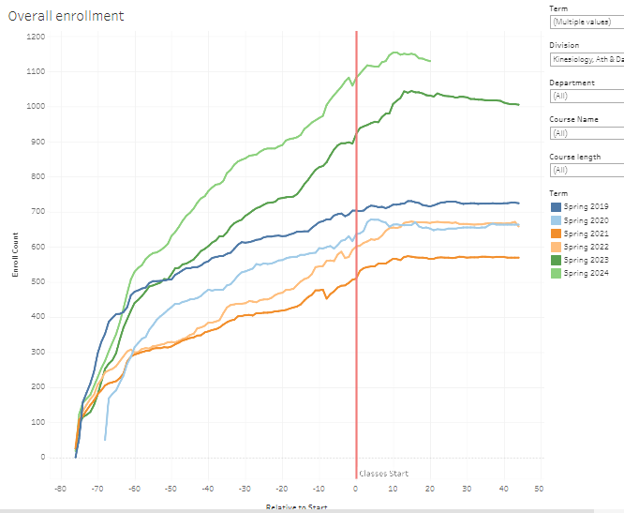
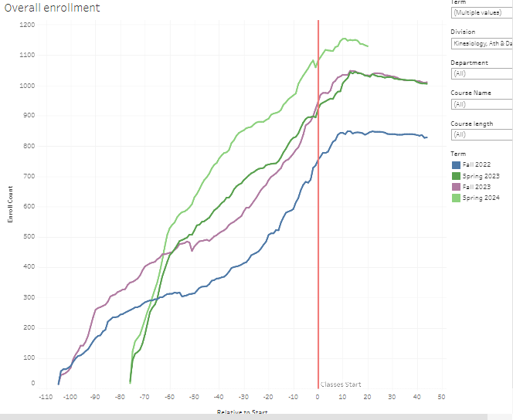
Kinesiology, Art, & Dance

Slide 11
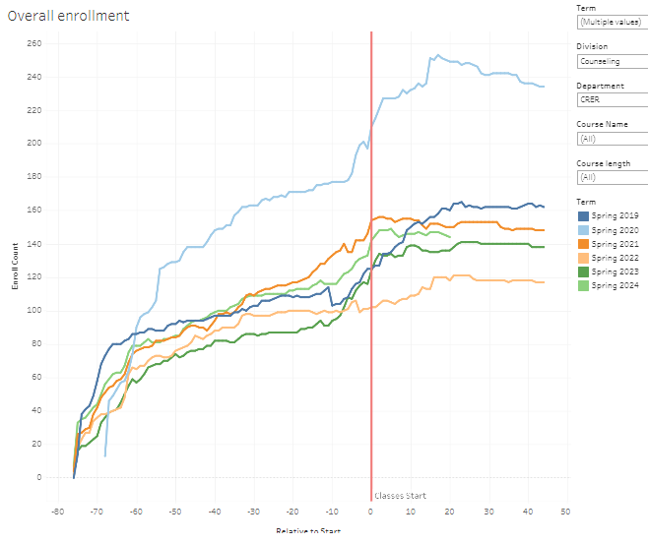
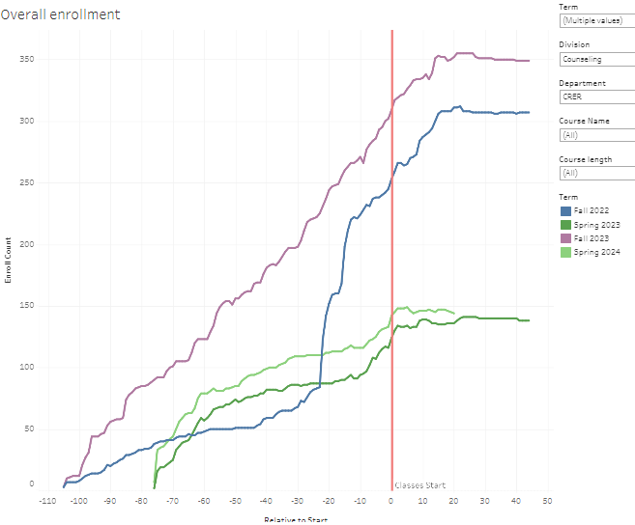
Counseling

Slide 12
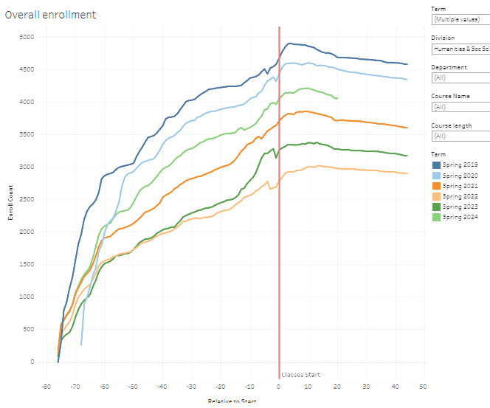
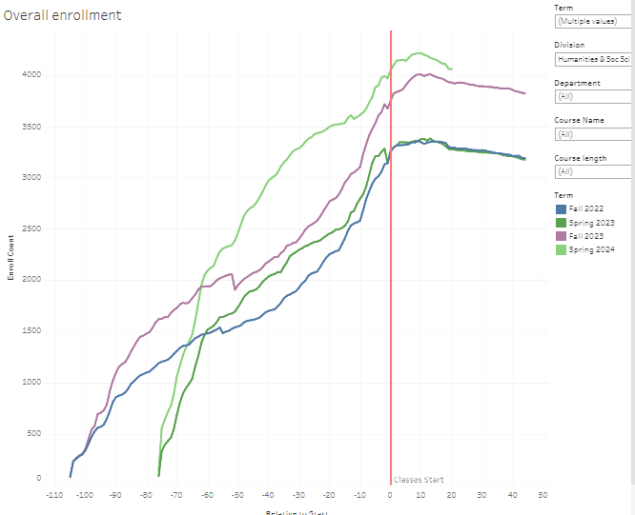
Humanities & Social Science

Slide 13
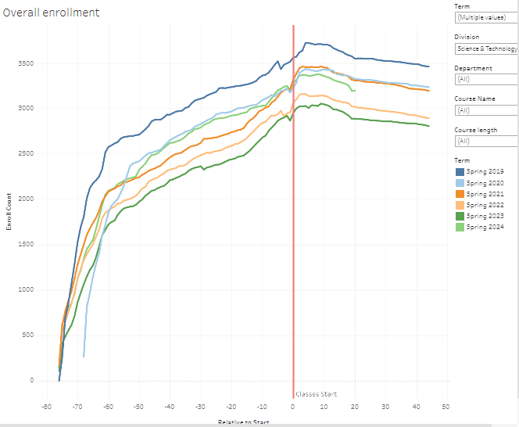
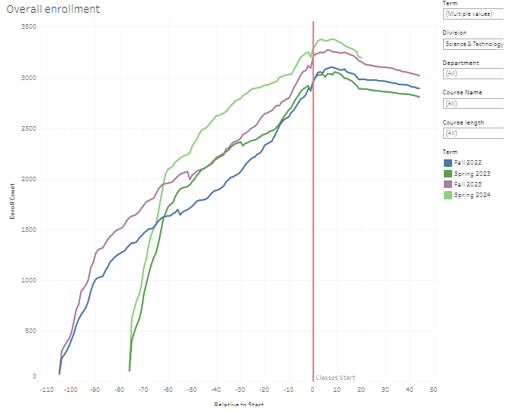
Science & Technology

Slide 14
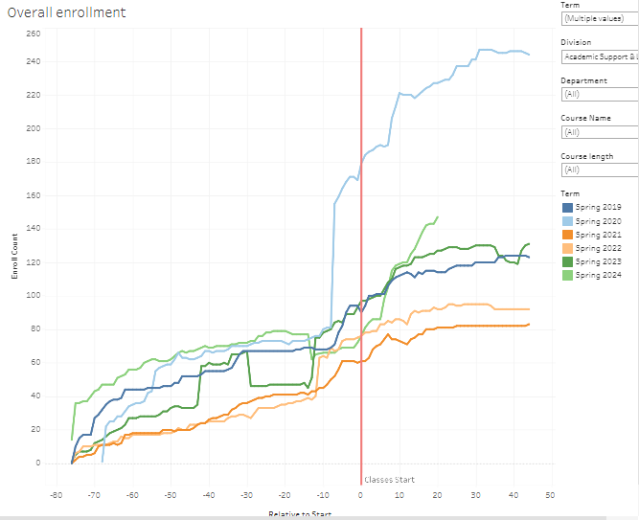
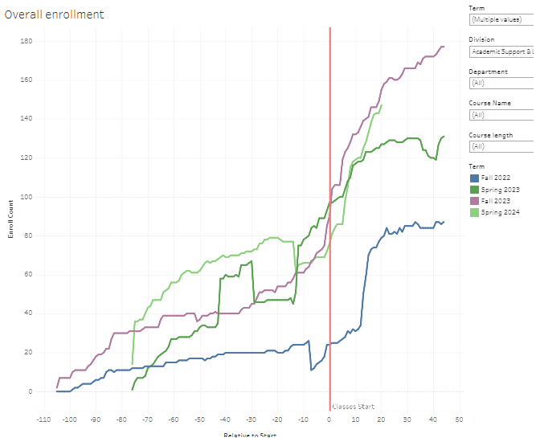
Academic Support & Learning Technologies (ASLT)

Slide 15
Stop Here

Slide 16
Course Enrollment and Modalities Update
EMP 1.3 Create a student-first course schedule
EMP 4.12 Offer key courses in multiple modalities
ACCJC Standard 2.6. The institution uses delivery modes and teaching methodologies that meet student and curricular needs and promote equitable student learning and achievement.
Office of Instruction
Presented to PBC
10.4.2023

Slide 17
Fall Course Schedule
1. Review data:
Reports for the prior 3 years
Student Modality Preference Survey
Course Availability Schedule in the Catalog
Timetable Creation
Conflict Resolution
9. Course Registration
Priority Registration Starts
Sept
Oct
Nov
Dec
Jan
Feb
March
April
May
June
July
Aug
Course, Modalities, and Program Planning
Faculty Assignments
Error Checking
Schedule on the Website
Semester Starts
See Details for Effective Social Media Outreach next slide
Finalization & Publication
Room Availability
Course Schedule Entry
10. Monitoring, Social Media Outreach, and Evaluation
Notes:
Curriculum Planning:
Deans work with academic departments and faculty to plan the courses that will be offered for the upcoming academic term or year.
This involves reviewing the existing curriculum, considering student demand, and identifying any new courses that need to be introduced.
Faculty Assignments and Course Modalities:
Deans collaborate with full-time and then adjunct faculty to determine the faculty members available to teach each course.
They consider the expertise and qualifications of the faculty to ensure that courses are assigned to the most suitable instructors.
Deans collaborate with faculty to determine the course modalities that meet students’ needs and demands.
Room Availability:
Deans coordinate with facilities management to identify the available classrooms and lecture halls for each course.
They consider factors such as class size, equipment requirements, and accessibility to assign appropriate rooms.
Course Scheduling Tool:
Deans and academic administrators input course information, faculty availability, and room options into the software, which helps optimize scheduling to minimize conflicts and maximize course offerings.
Timetable Creation:
Based on the inputs from the course planning, faculty assignments, course modalities, and room availability, deans create a preliminary timetable for the upcoming term.
This timetable includes the days and times when each course will be offered.
6. Conflict Resolution:
Deans and their teams review the preliminary timetable to identify any scheduling conflicts, such as overlapping courses, instructor availability issues, or room conflicts.
They work to resolve these conflicts by adjusting course times or assigning alternative rooms.
7. Finalization and Publication:
After resolving conflicts, the final course schedule is compiled.
Deans ensure that all necessary adjustments have been made and that the schedule aligns with the academic calendar.
Once finalized, the course schedule is published and made accessible to students and faculty through the institution's course registration system.
8. Course Registration Support:
Student Services Deans and academic administrators provide support to students during the course registration process.
They assist with resolving registration issues, managing waitlists, and handling course capacity adjustments as needed.
Example Specific Enrollment Strategies
9. Monitoring and Evaluation:
Throughout the academic term, deans monitor the course schedule's effectiveness and address any unexpected challenges that arise.
They may collect feedback from students and faculty for future improvements.

Slide 18
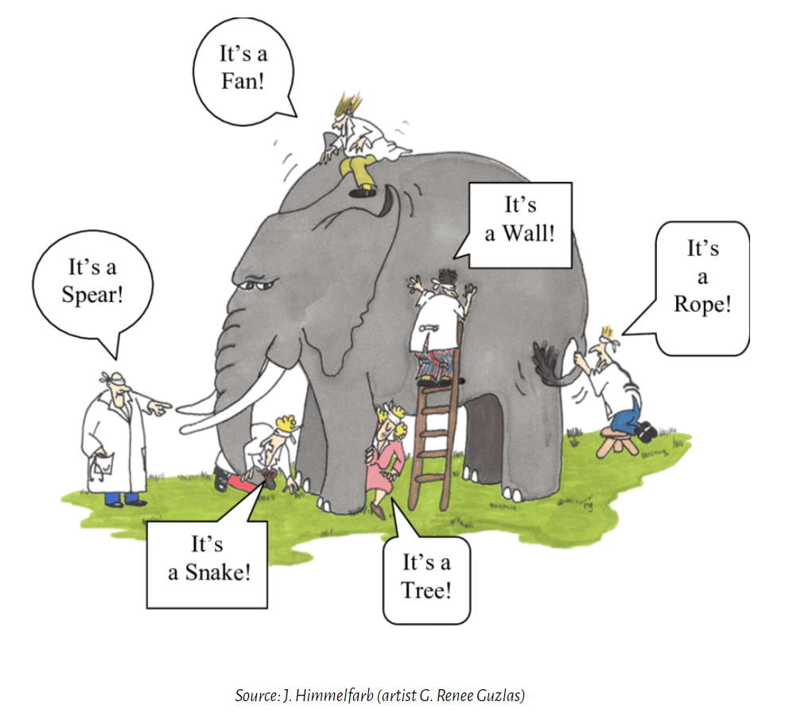
The Blind Men and The Elephant
Embrace the diversity of the individual as part of the unity of the collective.
https://www.sloww.co/blind-men-elephant/

