Slide 1
AB 1705 Implementation
May 5, 2023
Science & Technology Division Meeting
Data prepared by the Office of Planning, Research, and Institutional Effectiveness (PRIE)

Slide 2
AB 1705 Legislation
Addresses some of the remaining issues raised by AB 705
Implementation by July 1, 2023

Slide 3
AB 1705 Required Actions by July 1, 2023
Default placement and enrollment into transfer-level English and math/quantitative reasoning courses with no enrollments in pretransfer level.
As of Fall 2022, we no longer offer pre-transfer level math or English courses (with the exception of dual enrollment)

Slide 4
AB 1705 Required Actions by July 1, 2023
Students shall begin in the transfer-level English and math coursework that satisfies a course requirement for the students’ intended certificate, degree, or transfer requirement (POS)
Do we have transfer-level pre-requisites to these courses?

Slide 5
AB 1705 Required Actions by July 1, 2023
Students shall begin in the transfer-level English and math coursework that satisfies a course requirement for the students’ intended certificate, degree, or transfer requirement (POS)
Do we have transfer-level pre-requisites to these courses?
No, because our prerequisite statements all include the phrase “or multiple measures assessment:
Math 251 Prerequisites: MATH 222 (offered at CSM or Skyline) or MATH 225 or appropriate score on the College Placement Test or other multiple measures assessment.

Slide 6
AB 1705 Required Actions by July 1, 2023
The College shall not require students to repeat coursework that they have successfully completed in high school or college or take coursework that repeats competencies that the student has demonstrated (CPR).
This needs attention

Slide 7
Our default placement rules don’t properly place students who’ve taken Pre-Calc or higher in HS
Placements from Fall 2019, Fall 2020, Fall 2021, and Fall 2022
 | Pre-Transfer |  | Transfer with Support |  |  |  | Transfer without Support (first level) |  |  |  | Transfer without Support (second level)
Highest Course Taken in High School | *M30 | *M40 | *M17 | *M19 | *M43 | *M45 | *M16 | *M18 | *M48 | *M50 | *M60 | *M53 | *M70 | *M80
Algebra 1 |  |  | 87 | 16 | 2 |  | 283 |  |  | 3
Algebra 2 |  | 2 | 216 | 111 | 4 | 3 | 234 | 29 | 9 | 12
Calculus or higher |  | 1 | 25 | 4 |  |  | 284 | 138 | 1 | 1 | 5
Geometry | 4 | 3 | 193 | 38 | 1 |  | 118 | 1 | 1 | 8
Integrated Math 1 | 1 |  | 29 | 4 |  | 1 | 59
Integrated Math 2 |  |  | 25 | 1 |  | 1 | 54 |  |  | 1
Integrated Math 3 |  |  | 19 | 3 |  | 3 | 37 | 4 |  | 1
Integrated Math 4 |  |  | 3 | 6 |  |  | 31 | 4
Pre-algebra or lower |  |  | 17 | 3 |  | 1 | 109 |  |  | 1
Pre-calculus |  |  | 32 | 53 |  | 1 | 164 | 52 | 3 | 8 | 1
Statistics |  |  | 69 | 46 |  |  | 139 | 23 | 7 | 2
Trigonometry | 1 |  | 23 | 21 |  |  | 96 | 24 | 1
Unknown | 5 | 3 | 38 | 14 | 6 | 1 | 41 | 15 | 6 | 14
Grand Total | 11 | 9 | 776 | 320 | 13 | 11 | 1649 | 290 | 28 | 51 | 6

Slide 8
Let’s update our default placement table in the Catalog and on the Placement website
 | Math Code | Math Courses
Pre-transfer (Fall 2019-Spring 2022 courses) | *M30 | Math 110, 190, 820
 | *M40 | Math 120
1st Level Transfer with Support | *m17 | 200+800
 | *m19 | 130,830,225, 825, 241,841
 | *m43 | ma 800,145
 | *m45 | MA 825, 830, 841, 201
1st Level Transfer without Support | *m16 | 145, 200, 201
 | *m18 | 125, 130, 150, 225,241
 | *m48 | MA 200
 | *m50 | MA125, 130,145,147,200,225,241
Upper Level Transfer | *m53 | MA 222
 | *m60 | MA 251
 | *m70 | MA 252, MA 268
 | *m80 | MA 253, MA 270
 | No code | MA 275

Slide 9
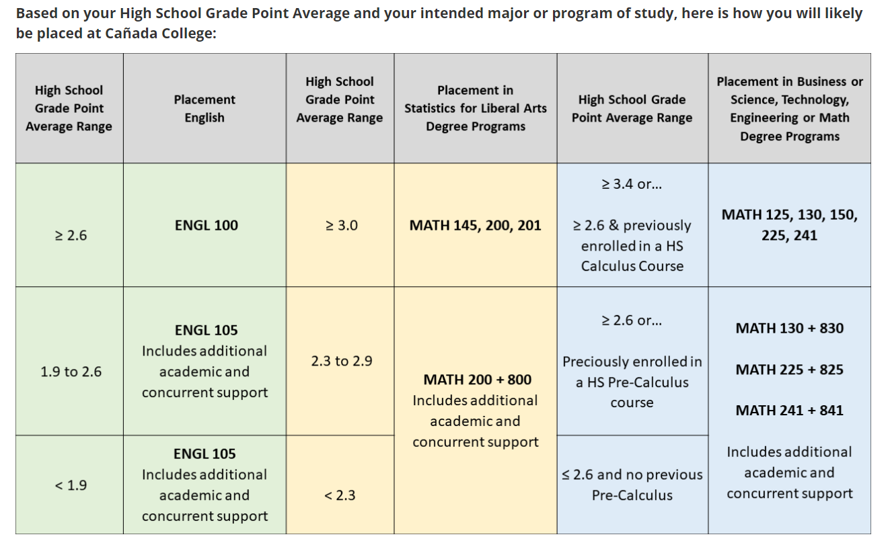
Our current default placement does not place students into calculus or higher

Slide 10
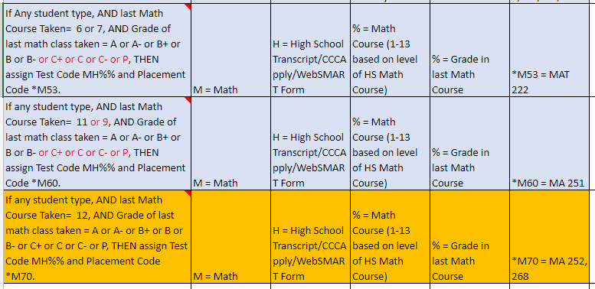
Proposed revision to default placement logic

Slide 11
AB 1705 Additional Actions by July 1, 2023
Guided placement and self placement shall not result in placement or enrollment below the transfer-level or into transfer-level coursework that does not satisfy the requirements for the student’s program of study
How do we consider the impact of self placement (or avoidance of math and English) on students with an “unknown” program of study?
Math 225 may be an issue here as well, for BSTEM students

